Slide 1

SICAS Summit
2017
DROP-IN REPORTING WITH GROOVY
September 2017, Villa Roma

Slide 2
Session Rules of Etiquette
Please silence your mobile device(s)
If you must leave the session early, please do so as discreetly as possible
Please avoid side conversation during this session
Thank you for your cooperation!
SICAS Summit 2017, Villa Roma

Slide 3

Drop-In Reporting With Groovy
Edward Cole
Jamestown Community College
Senior Programmer/Analyst
Almost 25 years of Oracle
16 years of Banner
SICAS Summit 2017, Villa Roma

Slide 4
A Real Solution to a Real Problem
Oracle Reports is Going Away.
We’ve used Oracle Reports as our primary reporting tool since we started using Oracle, almost 25 years ago.
We created over 600 Oracle Reports applications in the 15 years we’ve been using Banner
Oracle has been giving gentle hints for some time that we should move on to another tool.
It never did a good job of producing data extracts, which many of our users prefer to a printed report these days.
SICAS Summit 2017, Villa Roma

Slide 5
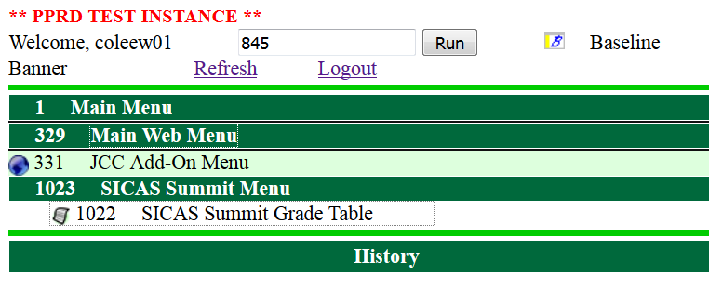
A Practical Reporting Tool
Before we begin, let’s see what our reports look like from the user’s point of view.
Our user selects #1022: SICAS Summit Grade Table from our menu.
SICAS Summit 2017, Villa Roma

Slide 6
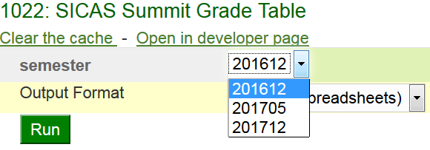
A Practical Reporting Tool
A parameter form opens up with a list of values for the semester.
The user runs the application with the output format set to CSV (for spreadsheets).
SICAS Summit 2017, Villa Roma

Slide 7
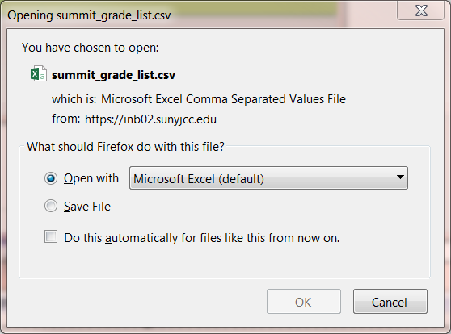
A Practical Reporting Tool
SICAS Summit 2017, Villa Roma

Slide 8
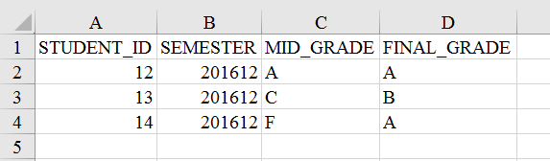
A Practical Reporting Tool
And here’s our data.
But the interesting part about this is what you can’t see.
SICAS Summit 2017, Villa Roma

Slide 9
Pause for effect...
SICAS Summit 2017, Villa Roma

Slide 10
The interesting part…
… is that this only took 8 lines of code.
report(title: "Summit Grade List") {
param(name: "semester", label: "semester") {
list_of_values query: """select distinct semester
from summit_grades"""
}
sql query: """select * from summit_grades
where semester = :semester"""
}
You just have to save this file as summit_grade_list.groovy and “drop it in” to the right directory. [Full disclosure: It has to be added to the menu separately]
SICAS Summit 2017, Villa Roma

Slide 11
It Started with a Dream…
Many of our reports are just an SQL query with enough wiring to deliver the output to our users.
What if we could drop our query into a container that will collect the parameters from our users and return the formatted output to them?
What if we could use a simple DSL (Domain-specific language) to define the reports that are more complicated than one can do comfortably with a single select statement?
Groovy gives us what we need to make this dream a reality.
SICAS Summit 2017, Villa Roma

Slide 12
But Cold Reality Also Played a Part.
There are some practical considerations to our reporting tool.
Free or open source tools
No licensing fees
High quality
Widely used and not tied to a single vendor.
Freedom
We own our own reports
Not locked away on a web server
Not in a binary format
No IDE
SICAS Summit 2017, Villa Roma

Slide 13
What is this reporting system?
A Java Library (JAR file), written in Groovy, that creates and runs the reports
A Grails application that handles the interaction with the client
Report definitions are stored in a directory on the server
Protected by Git
Easy to search, edit, or modify through common tools
No binary formats
Paper reports are created by Jasper Reports
SICAS Summit 2017, Villa Roma

Slide 14
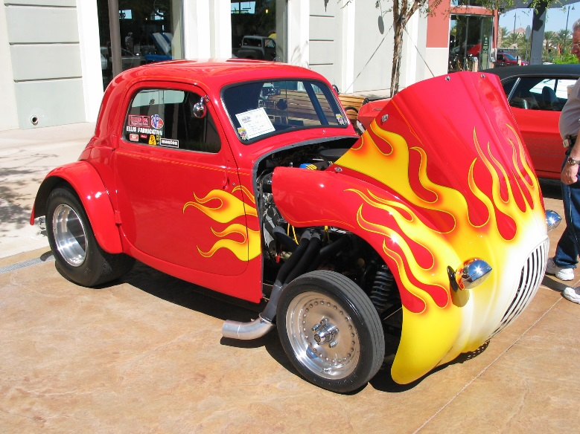
What is Groovy?
Groovy is a chopped, channeled, lowered, louvered and flame-painted Java.
Most Java code will compile and run correctly as Groovy without any changes.
It interacts seamlessly with Java code.
It gives you access to the enormous library of software available for the JVM.
It runs without recompilation on all major operating systems.
noego (https://commons.wikimedia.org/wiki/File:Fiat_Topolino_hotrod_front.jpg), „Fiat Topolino hotrod front“, https://creativecommons.org/licenses/by/2.0/legalcode
SICAS Summit 2017, Villa Roma

Slide 15
Why Groovy is groovy
Groovy gives us the following special features.
Easy-to-use interface for SQL and XML
Closures and functional programming
Scripting
Builders and DSL’s
“Easy” web applications through Grails
SICAS Summit 2017, Villa Roma

Slide 16
The Grails Application
The library contains no user interaction.
The Grails application is the client interface
Gathering parameters
Delivering output
Controlling access using the JCC menu system
Other client interfaces are possible and might be added in the future.
SICAS Summit 2017, Villa Roma

Slide 17
Jasper Reports
We liked Jasper Reports for several reasons.
It is a fully-functional report generator.
It is Java-Based and you can include it in Java programs.
It has XML source code.
You can develop it through either a GUI or a text editor.
It is free.
SICAS Summit 2017, Villa Roma

Slide 18
Example Reports
Let’s look at some examples from the developer’s point of view.
Plain SQL
A Groovy report with an SQL query
Dynamic SQL
A report with data created from arbitrary Groovy code
SICAS Summit 2017, Villa Roma

Slide 19
A pure SQL report
sql/summit_dict_tables.sql
/* List all data dictionary tables matching the pattern */
select * from dictionary
where table_name like nvl(upper(:table_name),'%')
order by table_name
Note the bind variable in the query, :table_name. When we run the report, it displays a parameter form which asks for a table name.
SICAS Summit 2017, Villa Roma

Slide 20
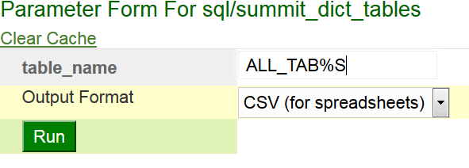
A pure SQL report
Enter ALL_TAB%S, to get a list of table-related data dictionary objects and run the report
TABLE_NAME | COMMENTS
ALL_TABLES | Description of relational tables accessible to the user
ALL_TAB_COLS | Columns of user's tables, views and clusters
ALL_TAB_COLUMNS | Columns of user's tables, views and clusters
ALL_TAB_COL_STATISTICS | Columns of user's tables, views and clusters
ALL_TAB_COMMENTS | Comments on tables and views accessible to the user
SICAS Summit 2017, Villa Roma

Slide 21
Groovy Example
This example will show how you create a report using my DSL.
The syntax is nothing more than Groovy, but I’ve created special methods which we will use as keywords to build reports.
We will build the example up piece by piece.
SICAS Summit 2017, Villa Roma

Slide 22
Groovy Example
This example will be a report that lists the tables belonging to a particular database schema and matching a given pattern.
First, we tell the builder that we are creating a report.
report(title: 'List User Tables') {
// Parameters, data generators and other
// interesting things will go here.
}
The “report” keyword starts the creation of a new report.
SICAS Summit 2017, Villa Roma

Slide 23
Groovy Example
Define a parameter named “owner” with a list of values
// Create a parameter for the owner of the table
param(name: 'owner', label: 'Owner') {
// Add a list of values that excludes Oracle schemas and
// schemas that don't own any tables
list_of_values query: """select username
from all_users
where oracle_maintained = 'N'
intersect
select owner from all_tables"""
}
“param” creates a field on the parameter form.
“list_of_values” creates a pull-down list with a set of possible values for the owner parameter.
SICAS Summit 2017, Villa Roma

Slide 24
Groovy Example
Add a second parameter.
// A second parameter for the table name. Make it default to '%'
param(name: 'table_name',
label: 'Table Name',
description: 'List tables matching this value, with Oracle wildcards.',
'default': '%')
SICAS Summit 2017, Villa Roma

Slide 25
Groovy Example
Finally, add a query that references the parameters.
// Get the data from an SQL query. This references the parameters with
// a colon.
sql query: """select table_name, comments
from all_tab_comments
where owner = :owner
and table_name like upper(nvl(:table_name,'%'))
and comments is not null
order by table_name"""
The “sql” method tells us to use the SQL query as the source of our data.
SICAS Summit 2017, Villa Roma

Slide 26
Groovy Example
/** A report that lists the tables belonging to a particular schema */
report(title: 'List User Tables') {
// Create a parameter for the owner of the table
param(name: 'owner', label: 'Owner') {
// Add a list of values that excludes Oracle schemas and
// schemas that don't own any tables
list_of_values query: """select username
from all_users
where oracle_maintained = 'N'
intersect
select owner from all_tables"""
}
// A second parameter for the table name. Make it default to '%'
param(name: 'table_name',
label: 'Table Name',
description: 'List tables matching this value, with Oracle wildcards.',
'default': '%')
// Get the data from an SQL query. This references the parameters with
// a colon.
sql query: """select table_name, comments
from all_tab_comments
where owner = :owner
and table_name like upper(nvl(:table_name,'%'))
and comments is not null
order by table_name"""
}
SICAS Summit 2017, Villa Roma

Slide 27
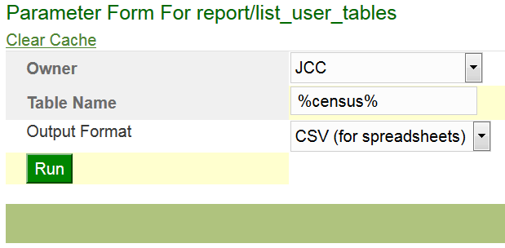
Groovy Example
When we run it, we see the following parameter form.
The select statement has turned into a pull-down list.
SICAS Summit 2017, Villa Roma

Slide 28
Groovy Example
The report returns the following data.
TABLE_NAME | COMMENTS
T_CENSUS_ROSTER | This table has one row per course per term.
T_STU_CENSUS_ROSTER | The roster of students in this course
SICAS Summit 2017, Villa Roma

Slide 29
Dynamic SQL Example
A dynamic SQL report allows you to create your query after you have seen the parameters.
Sample Data
We will use a table I created (SUMMIT_GRADES) for this example.
STUDENT_ID | SEMESTER | MID_GRADE | FINAL_GRADE
12 | 201612 | A | A
13 | 201612 | C | B
14 | 201612 | F | A
12 | 201705 | B | A
13 | 201705 | C | A
15 | 201712 | F | D
SICAS Summit 2017, Villa Roma

Slide 30
Dynamic SQL Example
Parameters
mid_or_final determines which grade column we will use.
grade singles out one grade for special treatment.
report(title: "Grade Totals") {
param(name: 'mid_or_final',
label: "Show Midterm or Final Grade?",
'default': 'F') {
list_of_values values: [['F', 'Final'],
['M', 'Midterm']]
}
param(name: 'grade',
label: 'What grade do we report on?',
'default': 'F') {
list_of_values values: ('A'..'F').collect{[it, it]}
}
SICAS Summit 2017, Villa Roma

Slide 31
Dynamic SQL Example
The query text is replaced by a function that returns the SQL text.
// The data source for this report is a dynamic SQL query.
// The dynamic_sql method takes a closure as an argument.
// This one will use the value of the mid_or_final parameter
// to choose which grade column to report on, and it will
// also use the grade parameter to set one of the column names.
dynamic_sql sql_closure: {
params ->
// Get the parameters from the closure arguments.
String mid_or_final = params.mid_or_final;
String grade = ('A'..'F').contains(params.grade)?params.grade:'F';
// Set the grade column
String grade_column = (mid_or_final == 'M')?'mid_grade':'final_grade'
// Return an SQL query. """
select semester,
count(${grade_column}) as ${grade_column},
sum(decode(${grade_column}, :grade, 1, 0)
) ${grade}_grades
from summit_grades
group by semester
order by semester """
}
SICAS Summit 2017, Villa Roma

Slide 32
select semester, count(mid_grade) as mid_grade, sum(decode(mid_grade, :grade, 1, 0) ) F_grades from summit_grades group by semester order by semester
Dynamic SQL Example
Run the report.
:mid_or_final = 'M'
:grade = 'F'
The closure returns the following SQL text.
select semester,
count(mid_grade) as mid_grade,
sum(decode(mid_grade, :grade, 1, 0) ) F_grades
from summit_grades
group by semester
order by semester
SEMESTER | MID_GRADE | F_GRADES
201612 | 3 | 1
201705 | 2 | 0
201712 | 1 | 1
SICAS Summit 2017, Villa Roma

Slide 33
Closure Query Example
You can generate your report data from arbitrary Groovy code.
Let’s look at an example that would be very hard to do in most reporting tools.
Suppose that we have a table with SQL queries in them.
SQL> select * from summit_sql;
We will create a report that lists the queries in this table that have errors.
ID | SQL_QUERY
1 | select user from dual
2 | select sloozle from fleem
SICAS Summit 2017, Villa Roma

Slide 34
Closure Query Example
Define a data_generator closure to create the report data
You need to declare the columns of the result set.
The environment of the script provides a database connection for you.
/** A second closure query example */
report(title: "Invalid Summit Queries") {
// Specify a closure to return the report data.
data_generator closure: {
// We have to define the columns explicitly
column(name: 'id', label: "ID");
column(name: 'sql_query', label: "SQL Query");
column(name: 'error', label: "Error");
// "sql" is a pre-defined groovy.sql.SQL object
def queries = sql.rows("select * from summit_sql order by id");
SICAS Summit 2017, Villa Roma

Slide 35
Closure Query Example
// Loop through all the rows in the table and test each query
queries.each {
q ->
query_row = [id: q.id, sql_query: q.sql_query, error: ''];
// Test the query from the table by invoking explain_plan. If
// the query fails to compile, it will throw a SQLException.
try {
// Beware of Groovy's GString
String explainQuery = "explain plan for ${q.sql_query}"
sql.execute(explainQuery);
} catch (java.sql.SQLException e) {
query_row.error = e.getMessage();
}
if (query_row.error?.size()) {
// "row" is a predefined method that add a row
// to the result set.
row(query_row);
}
}
SICAS Summit 2017, Villa Roma

Slide 36
Closure Query Example
When we run the report, we get a list of invalid SQL queries.
Note: This example was inspired by a real-life problem.
id | sql_query | error
2 | select sloozle from fleem | ORA-00942: table or view does not exist
SICAS Summit 2017, Villa Roma

Slide 37
Implementation
SICAS Summit 2017, Villa Roma

Slide 38
Groovy Closures and Delegation
Closures
They are functions that can be used like all other variables
Delegates
A Groovy method (i.e. a block of Groovy Code) can reference things that don’t exist at the time the code was compiled.
You can specify that it look for the missing methods and properties in another object, called the delegate.
SICAS Summit 2017, Villa Roma

Slide 39
Builders
Instance of groovy.util.BuilderSupport
Keep track of the tree structure implicit within Groovy code
report(title: "Sample report") {
// When this closure executes, the parent node will be the object created
// by the report method.
param(name: "sample_parameter") {
// When this closure is executed, the parent node will be the parameter
// created by the param method.
}
}
Requires you to implement three methods
createNode
addParent
nodeCompleted
SICAS Summit 2017, Villa Roma

Slide 40
Into the code
Here are a few of the key classes in the package
SourceFactory
This fetches the source code for reports (returned as a String)
ReportObjectFactory
This gets the source code from a SourceFactory and calls the eval method on a SimpleReportBuilder to create the requested object
SimpleReportBuilder
This executes a build script and returns the object that is created.
SICAS Summit 2017, Villa Roma

Slide 41
SimpleReportBuilder – eval
/** Evaluate a report builder script and return the results */
def eval(String text) {
def shell = new GroovyShell()
try {
// Wrap the text in a closure so that it doesn't execute
// immediately. This gives us the chance to change
// its delegate.
Closure c = shell.evaluate("{->$text}")
c.setDelegate(this)
// Execute the build script and add the
// source code to the object created.
def b = c()
if (b instanceof Buildable) {
b.source = text
}
return b;
} catch (BuildException e) {
e.source = text;
throw e
}}
SICAS Summit 2017, Villa Roma

Slide 42
SimpleReportBuilder
The createNode method uses an associative array (hash map) of functions to create a new object.
Object createNode(Object name, Map attributes, Object value) {
if (!nodeFactory[name]) {
throw new BuildException("'$name' is not a valid build method. Valid values are ["
+ nodeFactory.keySet().join(', ') + "]");
}
assert name in nodeFactory.keySet()
def n = nodeFactory[name].create(name, attributes, value)
return n
}
SICAS Summit 2017, Villa Roma

Slide 43
SimpleReportBuilder
This is a sample of the functions called by createNode.
private nodeFactory = [
report: [
create: {
String name, Map attributes, def value ->
def report = new SimpleReport(attributes)
assert report
if (value) {
report.description = value
}
return report
},
implClass: SimpleReport,
],
SICAS Summit 2017, Villa Roma

Slide 44
SimpleReportBuilder
The setParent method uses a two-dimensional array keyed by parent and child class.
void setParent(Object parent, Object child) {
def parentClass = parent.getClass()
def farm = addChildFarm[parent.getClass()]
if (! farm[child.getClass()]) {
def parentMethod = classMethodNames[parentClass]
def childMethod = classMethodNames[child.getClass()]
throw new BuildException("You cannot embed a $childMethod within a $parentMethod. "
+ "Valid options are: [${farm.keySet().collect { classMethodNames[it]}.join(',')}]")
}
def z = farm[child.getClass()](parent, child)
debug "z=$z"
z
}
(classMethodNames is a map from the report object class to the keyword used to build it. It is used here to produce a meaningful error message.)
SICAS Summit 2017, Villa Roma

Slide 45
SimpleReportBuilder
Here is a sample from the addChildFarm used by setParent.
/** Each entry in this table is a closure that attaches the child to the
* parent. The keys for the map are a subset of the cross-product of the
* classes that can go into a SimpleReport.
*
* Note that the keys of the map are actual Java classes, not their names.
* It is very important that they be wrapped in parentheses.
*/
def addChildFarm = [
(SimpleReport): [
(Param): {
parent, child ->
parent.addParam(child)
},
(ParamForm): {
parent, child ->
assert !parent.params
parent.params = child
}
SICAS Summit 2017, Villa Roma

Slide 46
Jasper Reports
Design reports in the GUI developer environment and save them as .jrxml (a schema of XML)
Text-based
We extract parameters, subreports, and images using standard XML tools.
Look for existing parameter forms with same name
Compile reports before running them
Use Jasper Reports to run the report and format the output.
SICAS Summit 2017, Villa Roma

Slide 47
Tell me more!
The simple report library is available at
https://github.com/ewcole/simple_report
I can share the Grails application with you upon request.
SICAS Summit 2017, Villa Roma

